Slide 1
Franklin County Economic Development & Planning Ruchelle Pride, Interim Director Emanuel Torres, Asst. Director Walter Dillard, Asst. Director

Slide 3
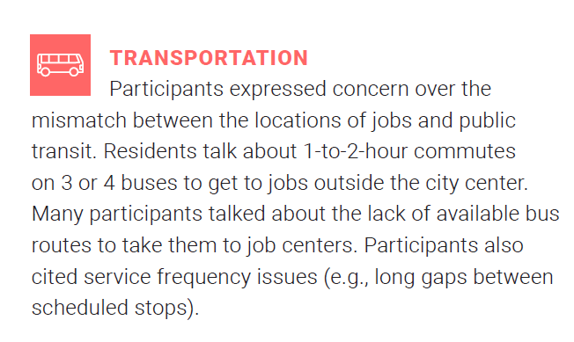
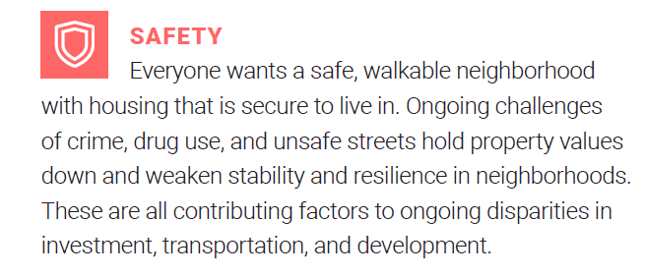
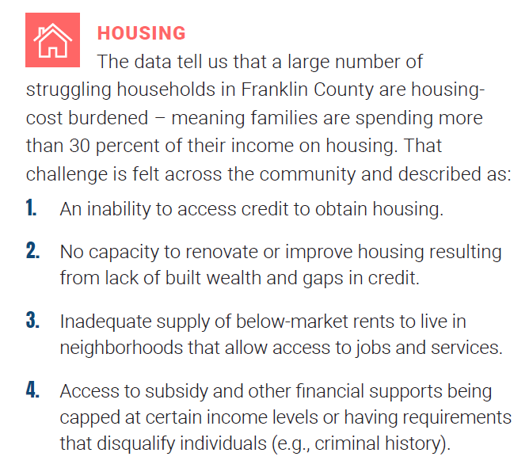

Slide 4
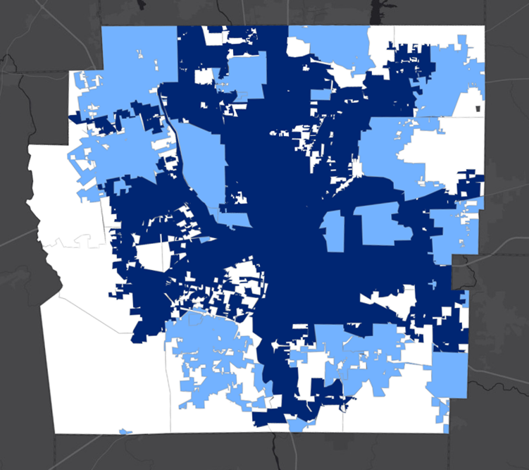
SERVICE AREAS
Unincorporated (White)
17 Townships
“Balance of the County” (Light Blue)
16 Cities + 10 Villages
Columbus (dark blue)
County-wide
Property Tax Incentives (CRA / EZ / TIF / AEZ)
Land Trust
Magnet Fund*
*Investment priority outside of the City of Columbus
Infrastructure Bank
Workforce Development
Partnerships

Slide 5
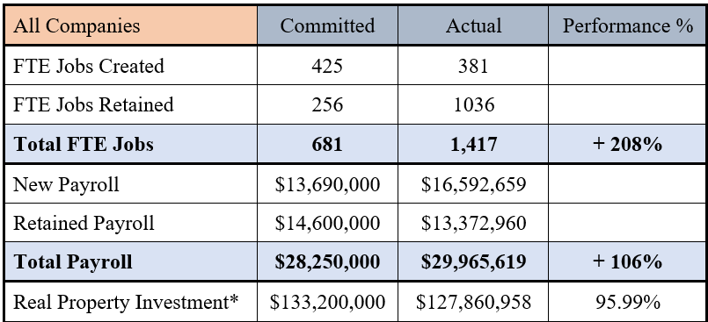
PROMOTING QUALITY WORK OPPORTUNITIES FOR FRANKLIN COUNTY RESIDENTS
Property Tax Incentives
Summary Statistics For All Companies and Projects Currently Receiving Abatements
Property tax abatement is a tool provided to counties, townships and municipalities to promote economic development. The ED Division administers the State’s Community Reinvestment Area (CRA) and Enterprise Zone (EZ) abatement programs within the unincorporated areas of Franklin County. A TIF allows for PILOT for public infrastructure investment.

Slide 6
ASSISTING FRANKLIN COUNTY COMMUNITIES PREPARE FOR JOB & POPULATION CHANGE
Affordable Housing to Sustainable Housing
LAND TRUST:
The Central Ohio Community Land Trust (COCLT) is a 501(c)(3) nonprofit organization established in 2018 in partnership with the City of Columbus and Franklin County
The Commissioners have made a commitment of $4,750,000 to COCLT for affordable housing activities. In addition to $2.6M to capitalize predevelopment activities.
To date – 14 projects have been funded
MAGNET FUND
Commenced in 2020, $25.6 Million to various community partners
Capital Investments = $733.4 Million
Total # of Affordable Housing Units = 2,457

Slide 7
ASSISTING FRANKLIN COUNTY COMMUNITIES PREPARE FOR JOB & POPULATION CHANGE
Franklin County Infrastructure Bank
The Franklin County Infrastructure Bank continued to assist Franklin County municipalities in creating favorable conditions for economic development.
Since the program began in 2015, the FCIB has made
10 loans to 7 municipalities
Loan Commitments: $10,837,000 approx.
Interest Revenue: $ 774,000 approx.

Slide 8
REDUCING DISPARITIES AND EXPANDING ECONOMIC INCLUSION EFFORTS
Supporting Equity, Diversity & Inclusion Efforts
EQUITY ALLIANCE
ED continues to assist the Office of Diversity, Equity, & Inclusion and the Equity Alliance in launching a new Community Development Financial Institution (CDFI) – through the Columbus Urban League
SMALL & EMERGING BUSINESS ENTERPRISE - (SEBE)
ED has begun to implement reporting provisions on contractual agreements to capture DE&I efforts.
Disadvantaged Business Enterprise - (DBE)
Minority Business Enterprise - (MBE)
Women Business Enterprise - (WBE)
Encouraging Diversity, Growth and Equity – (EDGE) Certified Business Enterprise
Local Economically Disadvantaged Enterprise - (LEDE)
Veteran Business Enterprise – (VBE)

Slide 9
Thank you!
Contact Info:
Email: RuchellePride@franklincountyohio.gov
Office Phone: 614-525-7301
Cell Phone: 614-286-5528
This Photo by Unknown Author is licensed under CC BY-SA

